Slide 1
Reviews on Group 15
Group Members:
Nopphiphat Suraminitkul (Nopi)
Ayush Singh
Somnath Jogelkar
Juhi Sinha

Slide 2
Actors
User
Basic actor.
Has access to create or join a group.
Moderator
Inherited from Group member who created the group.
has access to manage the group, such as create a movie event and open a vote for the event.
Group member
Inherited from user who joined or created a group.
Has access to engage the group events.
Movie review site
A external website provides reviews and trailers.
Notes:
Group member shouldn’t inherited from user who created a group, because users who create a group are moderators.

Slide 3
Use Cases List: User related
ID | Name | Description
UC01 | Login in | Every user has to login before using this application.
UC02 | Create a group | User creates a group and become the moderator of the group.
UC03 | Join a group | User joins a group and become a member of the group.
Notes:
View History Functions missing

Slide 4
Use Cases List: Group Member related
ID | Name | Description
UC11 | Unsubscribe a Group | Group member unsubscribes the group.
UC12 | Search Movies | Group member searches movies in the group.
UC13 | Watch Trailers | Group member watches movie trailers.
UC14 | Watch Reviews | Group member watches movie reviews.
UC15 | Vote | Group member votes a movie in a voting event.
Notes:
Modify Vote Use Case is missing

Slide 5
Use Cases List: Moderator related
ID | Name | Description
UC21 | Invite People | Moderator invites people into the group.
UC22 | Pull a Movie List | Moderator pulls a movie list from an external website.
UC23 | Create a Movie Event | Moderator creates a movie event for members.
UC24 | Open a Voting Event | Moderator opens a voting event in a movie event.
UC25 | Elect Winner | The system counts the most voted movie.
UC26 | Remove Members | Moderator removes a member from the group.
Notes:
Populate Movies Use Case missing
Elect Winner Use Case should be with respect to actors and not system.

Slide 6
Overview
What artifacts your group reviewed
The key issues (5 to 7) found in each component:
Use Case Diagram
Use Case Specification
Class Diagram
Sequence Diagram

Slide 7
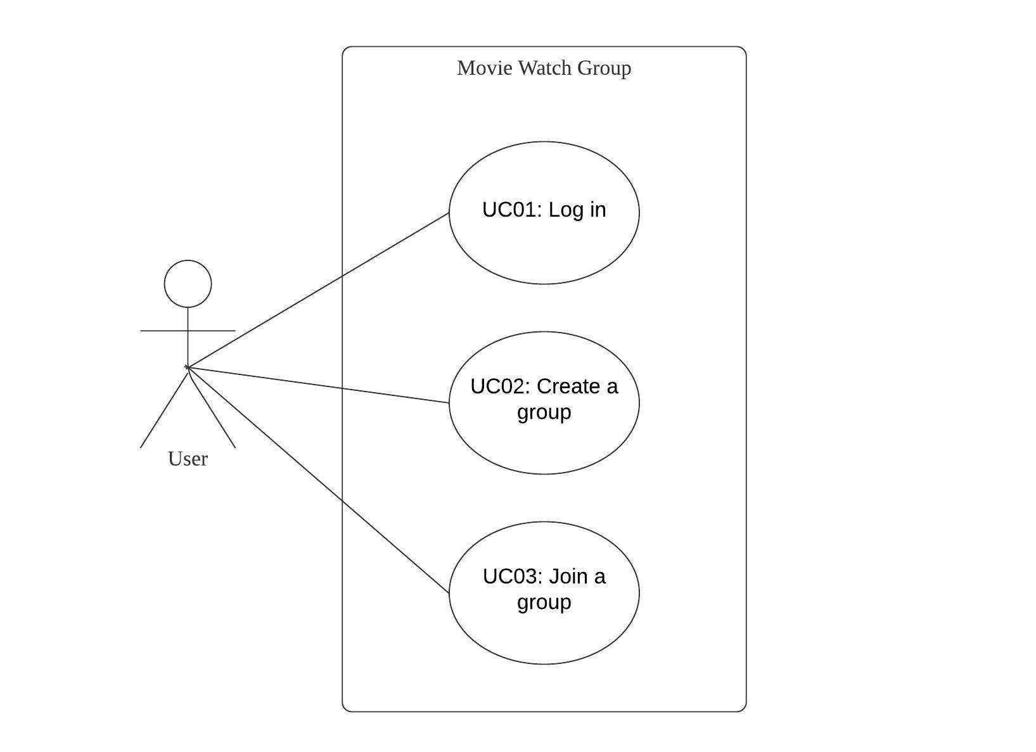
Use Case Diagram: User
Notes:
UC04: View History Use Case should be indicated

Slide 8
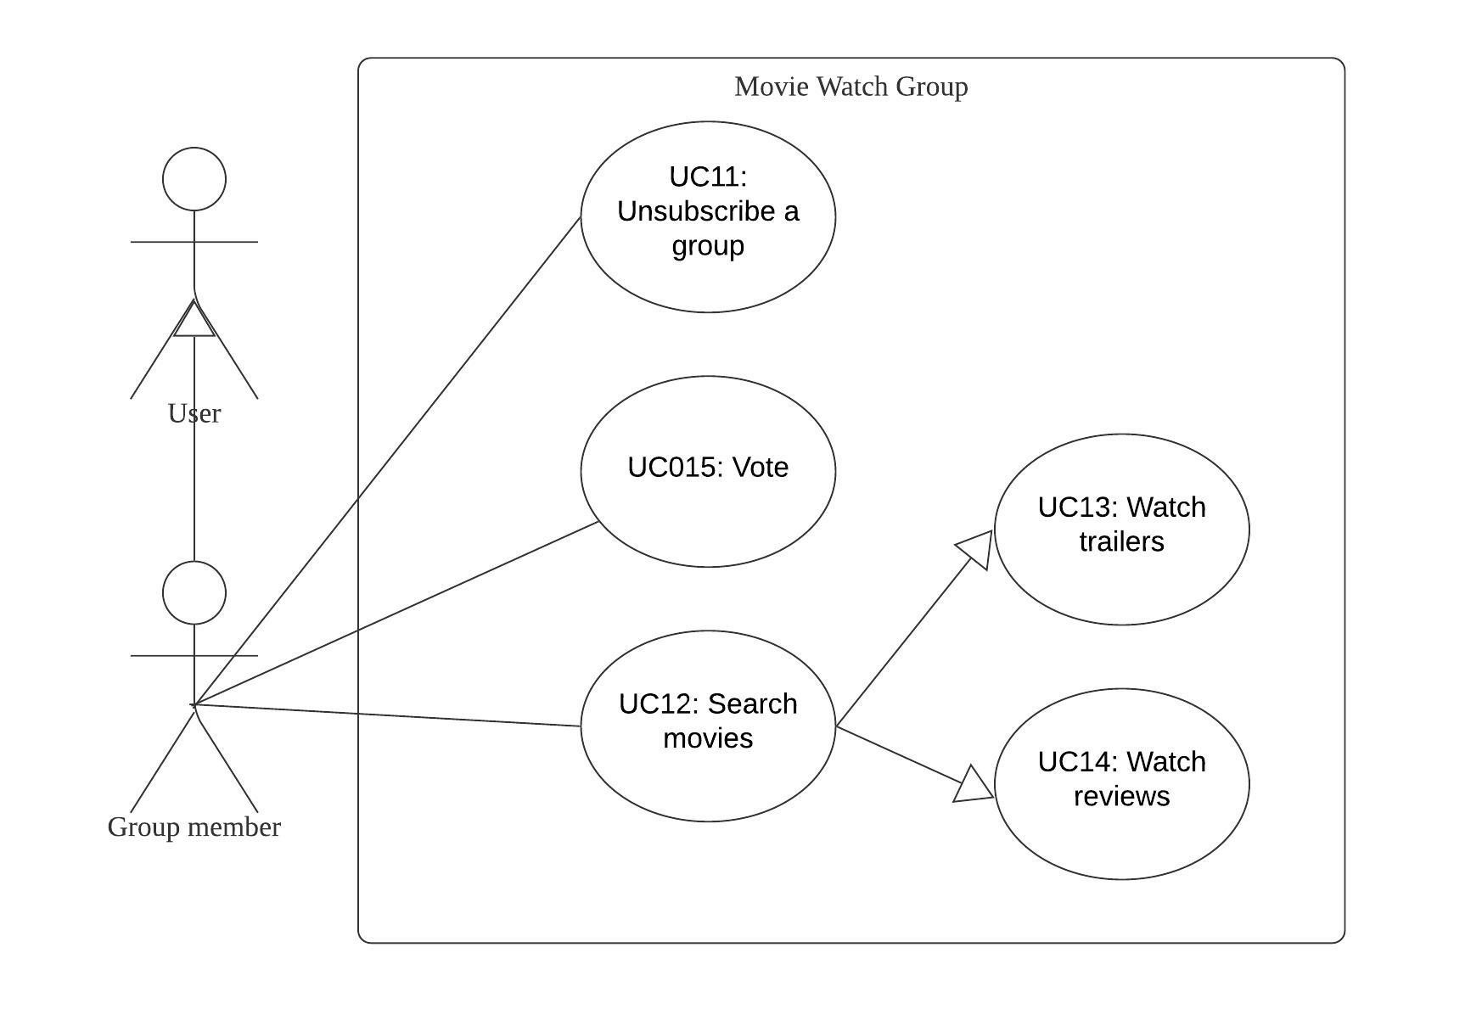
Use Case Diagram: Group Member
Notes:
UC16: Modify Vote Use Case should be indicated

Slide 9
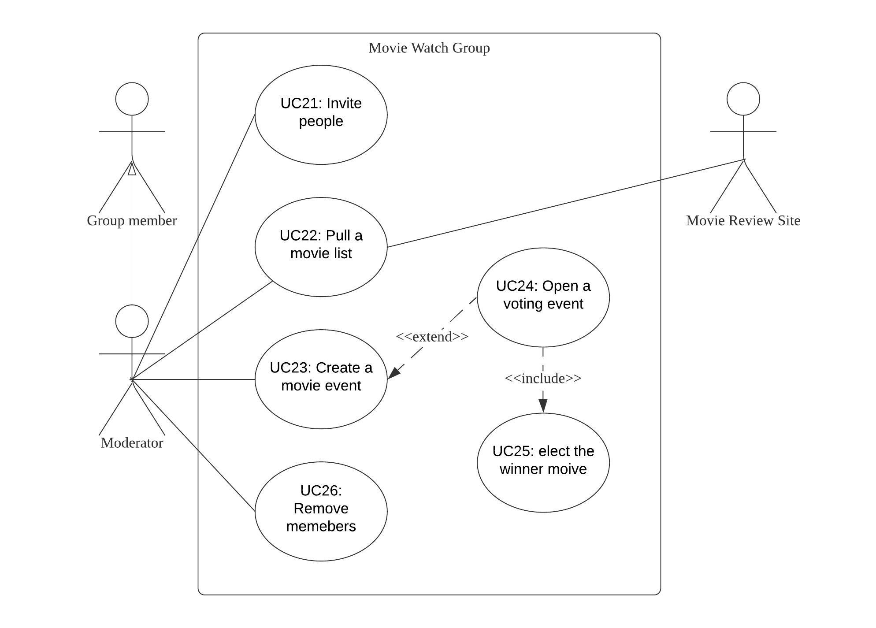
Use Case Diagram: Moderator
Notes:
Close Movie Voting Period ??
Arrow Missing?
UC26: Remove Members use case spelling is wrong
UC27: Close a voting event <- check if it is specified in the specification

Slide 10
Key Issues in Use Case Diagram
View History use case is missing: View History is one of the requirements that is mentioned in the Syllabus but not mentioned in the use case diagram.
UC26: Remove Members use case spelling is wrong.
Populate movie list use case missing: Pull a movie list use case is supposedly overshadowing and engulfing the populate movie list functionality. Populate movie list should be done by the moderator into the group, while pulling takes place from the server initiated by moderator. Populate movie should be a use case in itself.
Modify vote use case is missing: Modify Vote is one of the requirements that is mentioned in the syllabus but not mentioned in the use case diagram. It is a functionality that must be given to the Group members.
UC25: Elect winner is not a use case: Electing a winner is something that is done (votes calculated) by the system. And since system is not an actor, it is should not be a use case. Furthermore, it should not represented in the use case diagram, at least as a use case for a moderator.
A lot of other use cases are not listed that are apparently listed as functions in the class diagrams. Example: logout and change password. (If login is listed as a use case for User, then why not logout?)
Notes:
UC24: Open a voting event is unambiguous: The group opens a voting event, but does not give the specifics about voting periods (Does opening the voting event means voting periods get initiated too?)-???

Slide 11
Ways to resolve issues in Use Case Diagram
Creating a View History use case: View History is one of the requirements for the group members that is mentioned in the syllabus but not mentioned in the use case diagram. By creating this use case, we can specify the actors associated with it and clearly define a key functionality of the system.
UC26: Correcting Remove Members spelling: Corrected spelling will correctly indicate the use case and help us redirect to the correct diagram.
Creating a Populate movie use case: Populate movie list is one of the requirements that is mentioned in the syllabus but not mentioned in the use case diagram. By creating this use case, we can specify the actors associated with it and clearly define a key functionality of the system.
Creating a Modify Vote use case: Modify Vote is one of the requirements for the group members that is mentioned in the syllabus but not mentioned in the use case diagram. By creating this use case, we can specify the actors associated with it and clearly define a key functionality of the system.
UC25: Removing the elect winner use case: Since system is executing this whole functionality, and is not an actor, it is should not be a use case. Removing this use case will make the final use case diagram more concise and accurate.
Adding use cases that will complete and justify the presence of other use cases will help complete the diagram and capture the complete functionality of the diagram. For Example: Logout and Change Password for Basic User.

Slide 12
Use Case Spec: UC01 | Login
ID | UC01
Name | Login
Description | Every user has to login before using this application.
Pre Condition | The user has not logged in.
Post Condition | The user has access to its information.
Steps | User inputs username/email and password. User clicks login button. The system compares login information with database. If the information matches, allows the user to login, otherwise displays login error.
Notes:
UC01 (Login) Should have mentioned that user should already created an account, accessed login page for the system
UC01 (Login) Should mentioned clearly about what “its information” is referring to; Vague
UC01 (Login) Should include the numbering of steps

Slide 13
Use Case Spec: UC02 | Create a Group
ID | UC02
Name | Create a Group
Description | User creates a group and becomes the moderator of the group.
Pre Condition | The use has logged in.
Post Condition | The user becomes the moderator of the group.
Steps | User creates a group and names the group. The system creates the group into database. The system displays create successful information.

Slide 14
Use Case Spec: UC03 | Join a Group
ID | UC03
Name | Join a Group
Description | User joins a group and becomes the member of the group.
Pre Condition | User has logged in. There is at least one group.
Post Condition | The user becomes the member of the group.
Steps | User selects a group from the group list and joins the group.
Notes:
UC03 (Join Group) Should have mentioned that there is an invitation to join the group sent by the moderator
UC03 (Join Group) Should take into account of the steps when user was invited to join a group by moderator
UC03 (Join Group) Should have more steps listing the interaction between UI

Slide 15
Use Case Spec: UC11 | Unsubscribe a Group
ID | UC11
Name | Unsubscribe a Group
Description | Group member unsubscribes a group.
Pre Condition | The user is a member in the group.
Post Condition | The system remove the user from group list.
Steps | User unsubscribes the group. The system remove the user from group list.
Notes:
UC11 (Unsubscribe Group) Should have mentioned the steps listing the interaction between UI

Slide 16
Use Case Spec: UC12 | Search Movies
ID | UC12
Name | Search Movies
Description | Group member searches movies in the group.
Pre Condition | The user is the member of the group.
Post Condition | The system shows the searched movie information.
Steps | Group member types a movie name. If the group has the movie, the system displays the movie information. Otherwise, the system displays movie not exists.

Slide 17
Use Case Spec: UC13 | Watch Trailers
ID | UC13
Name | Watch Trailers
Description | Group member watches movie trailers.
Pre Condition | The user is the member of the group. The movie is in the movie list.
Post Condition | None.
Steps | Group member watches movie trailers.
Notes:
UC13 (Watch Trailers) Should have mentioned that the group members have already searched for the movies
UC13 (Watch Trailers) Should have mentioned that the group members are able to accessed the external trailer link
UC13 (Watch Trailers) Should have more steps listing the interaction between UI and external trailer website

Slide 18
Use Case Spec: UC14 | Watch Reviews
ID | UC14
Name | Watch Reviews
Description | Group member watches movie reviews.
Pre Condition | The user is the member of the group. The movie is in the movie list.
Post Condition | None.
Steps | Group member watches movie reviews.
Notes:
UC14 (Watch Reviews) Should have mentioned that the group members have already searched for the movies
UC14 (Watch Reviews) Should have mentioned that the group members are able to accessed the external review link
UC14 (Watch Reviews) Should have more steps listing the interaction between UI and external reviews website

Slide 19
Use Case Spec: UC15 | Vote
ID | UC15
Name | Vote
Description | Group member votes for a movie in a voting event.
Pre Condition | The moderator has opened a voting event. The voting event is not closed.
Post Condition | The system add a vote for the voted movie.
Steps | The user votes for a movie. The system add a vote for the voted movie.
Notes:
UC15 (Vote) The naming convention for the use case should be <VERB> <NOUN>
UC16 (Modify Vote) Use Case Missing

Slide 20
Use Case Spec: UC21 | Invite People
ID | UC21
Name | Invite People
Description | The moderator invite users to the group.
Pre Condition | The user is the moderator of the group. The invited user is not in the group.
Post Condition | The system adds the invited user to the group.
Steps | The moderator invite a user from the unjoined list into the group. The system adds the user to the group.
Notes:
UC21 (Invite People) The invite people use case doesn’t add user to the group, it just sends invitation to join the group
UC21 (Invite People) Should have more steps listing the interactions between UI

Slide 21
Use Case Spec: UC22 | Pull a Movie List
ID | UC22
Name | Pull a Movie List
Description | The moderator pulls a movie list from an external website.
Pre Condition | The user is the moderator of the group.
Post Condition | The system adds the pulled list into the movie list.
Steps | The moderator pulls a movie list from an external website. The system adds the pulled list into the movie list.
Notes:
UC22 (Pull Movie List) Should have mentioned that moderator have access to the Movie Review Website

Slide 22
Use Case Spec: UC23 | Create a Movie Event
ID | UC23
Name | Create a Movie Event
Description | Moderator creates a movie event for the group.
Pre Condition | The user is the moderator of the group.
Post Condition | The system add the movie event into the event history.
Steps | Moderator creates a movie event for the group. Moderator sets the time and movie for the event. The system add the movie event into the event history.
Extend | UC24: Open a Voting Event
Notes:
UC23 (Create Movie Event) Should have mentioned that they have successfully created movie event
UC23 (Create Movie Event) History isn’t mentioned in their use case diagram

Slide 23
Use Case Spec: UC24 | Open a Voting Event
ID | UC24
Name | Open a Voting Event
Description | Moderator opens a voting event for a movie event.
Pre Condition | The user is the moderator of the group.
Post Condition | The system closes the voting event by the closing time.
Steps | Moderator opens a voting event for a movie event. Moderator sets start and close time for the voting event. The system adds the voting event into movie event.
Include | UC25: Elect Winner
Notes:
UC24 (Open Voting Event) Should have added moderator has already created movie event prior to open voting event
UC24 (Open Voting Event) Should have mentioned that the moderator successfully created the movie voting event

Slide 24
Use Case Spec: UC25 | Elect Winner
ID | UC25
Name | Elect Winner
Description | The system counts the most voted movie.
Pre Condition | The voting event is closed.
Post Condition | The system informs the result to group members.
Steps | The system counts the most voted movie. The system records the winner. The system informs the group member.
Notes:
UC25 (Elect Winner) Not use case, since use case is not performed by System but the interaction between actors and it

Slide 25
Use Case Spec: UC26 | Remove Members
ID | UC26
Name | Remove Members
Description | The moderator removes a member from the group.
Pre Condition | The user is the moderator of the group. The group has least one members.
Post Condition | The system removes the member from the group list.
Steps | The moderator removes a member from the group. The system removes the member from the group list.
Notes:
UC26 (Remove Members) Should have more steps listing the interactions between UI

Slide 26
Key Issues in Use Case Specification
Misidentified pre-condition for UC[01/03/13/14]
Misidentified post-condition for UC[01/13/14]
Serial numbers of steps are missing and steps are not clearly elaborated
Steps regarding the interaction between the UI are missing
Naming Convention of Use Case should be <VERB> <NOUN> for UC15
Use Case for Modify Votes, View History, Populate Movies, etc. are missing
Elect Winner is not a use case, since it should be interaction between actors and system not things that are performed by the system
Notes:
UC01 (Login) Should have mentioned that user should already created an account, accessed the login page for the system
UC01 (Login) Should mentioned clearly about what “its information” is referring to
UC01 (Login) Should include the numbering of steps
UC03 (Join Group) Should have mentioned that there is an invitation to join the group sent by the moderator
UC03 (Join Group) Should take into account of the steps when user was invited to join a group by moderator
UC03 (Join Group) Should have more steps listing the interaction between UI
UC11 (Unsubscribe Group) Should have mentioned the steps listing the interaction between UI
UC13 (Watch Trailers) Should have mentioned that the group members have already searched for the movies
UC13 (Watch Trailers) Should have mentioned that the group members are able to accessed the external trailer link
UC13 (Watch Trailers) Should have more steps listing the interaction between UI and external trailer website
UC14 (Watch Reviews) Should have mentioned that the group members have already searched for the movies
UC14 (Watch Reviews) Should have mentioned that the group members are able to accessed the external review link
UC14 (Watch Reviews) Should have more steps listing the interaction between UI and external reviews website
UC15 (Vote) The naming convention for the use case should be <VERB> <NOUN>
UC16 (Modify Vote) Use Case Missing
UC17 (View History) Use Case Missing
UC21 (Invite People) The invite people use case doesn’t add user to the group, it just sends invitation to join the group
UC21 (Invite People) Should have more steps listing the interactions between UI
UC22 (Pull Movie List) Should have more steps listing the interactions between UI
UC22 (Pull Movie List) Should have mentioned that moderator have access to the Movie Review Website
UC23 (Create Movie Event) Should have mentioned that they have successfully created movie event
UC23 (Create Movie Event) History isn’t mentioned in their use case diagram
UC24 (Open Voting Event) Should have added moderator has already created movie event prior to open voting event
UC24 (Open Voting Event) Should have mentioned that the moderator successfully created the movie voting event
UC25 (Elect Winner) Not use case, since use case is not performed by System but the interaction between actors and it
UC26 (Remove Members) Should have more steps listing the interactions between UI

Slide 27
Ways to resolve issues in Use Case Specification
Identified the correct pre-conditions
Identified the correct post-conditions
Add serial numbers so the flow of the use case is clear
Refined the steps
Add the interactions between UI, such as clicks, redirects, etc.
Ensure that the naming convention follows the <VERB> <NOUN> pattern
Add the use case specification for modify votes, view history, populate movies, etc.
Remove elect winner use case specification since it’s not a use case

Slide 28
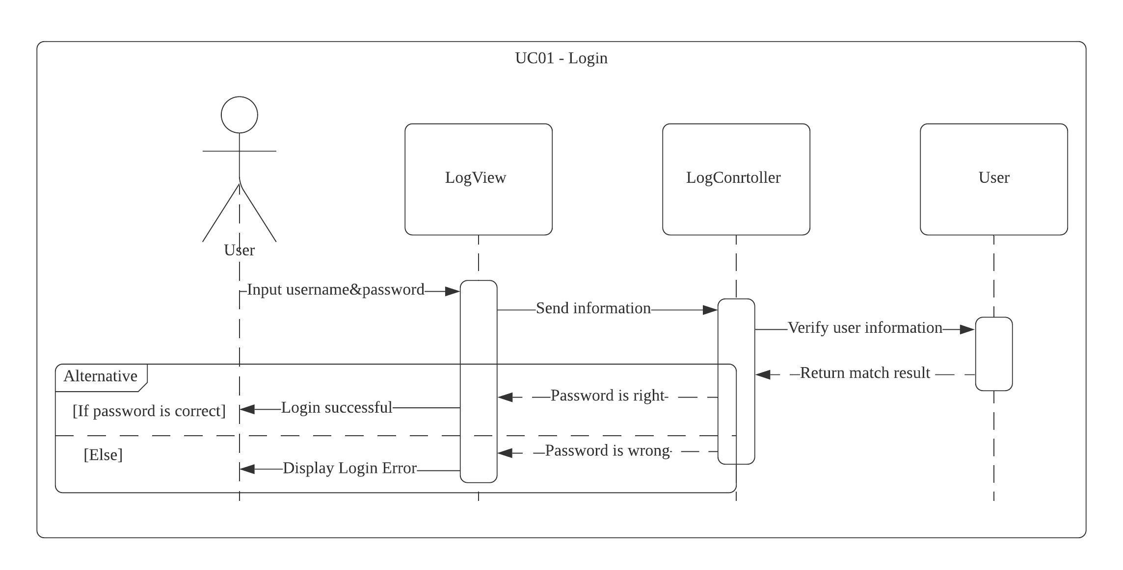
Sequence Diagram: UC01 - Login

Slide 29
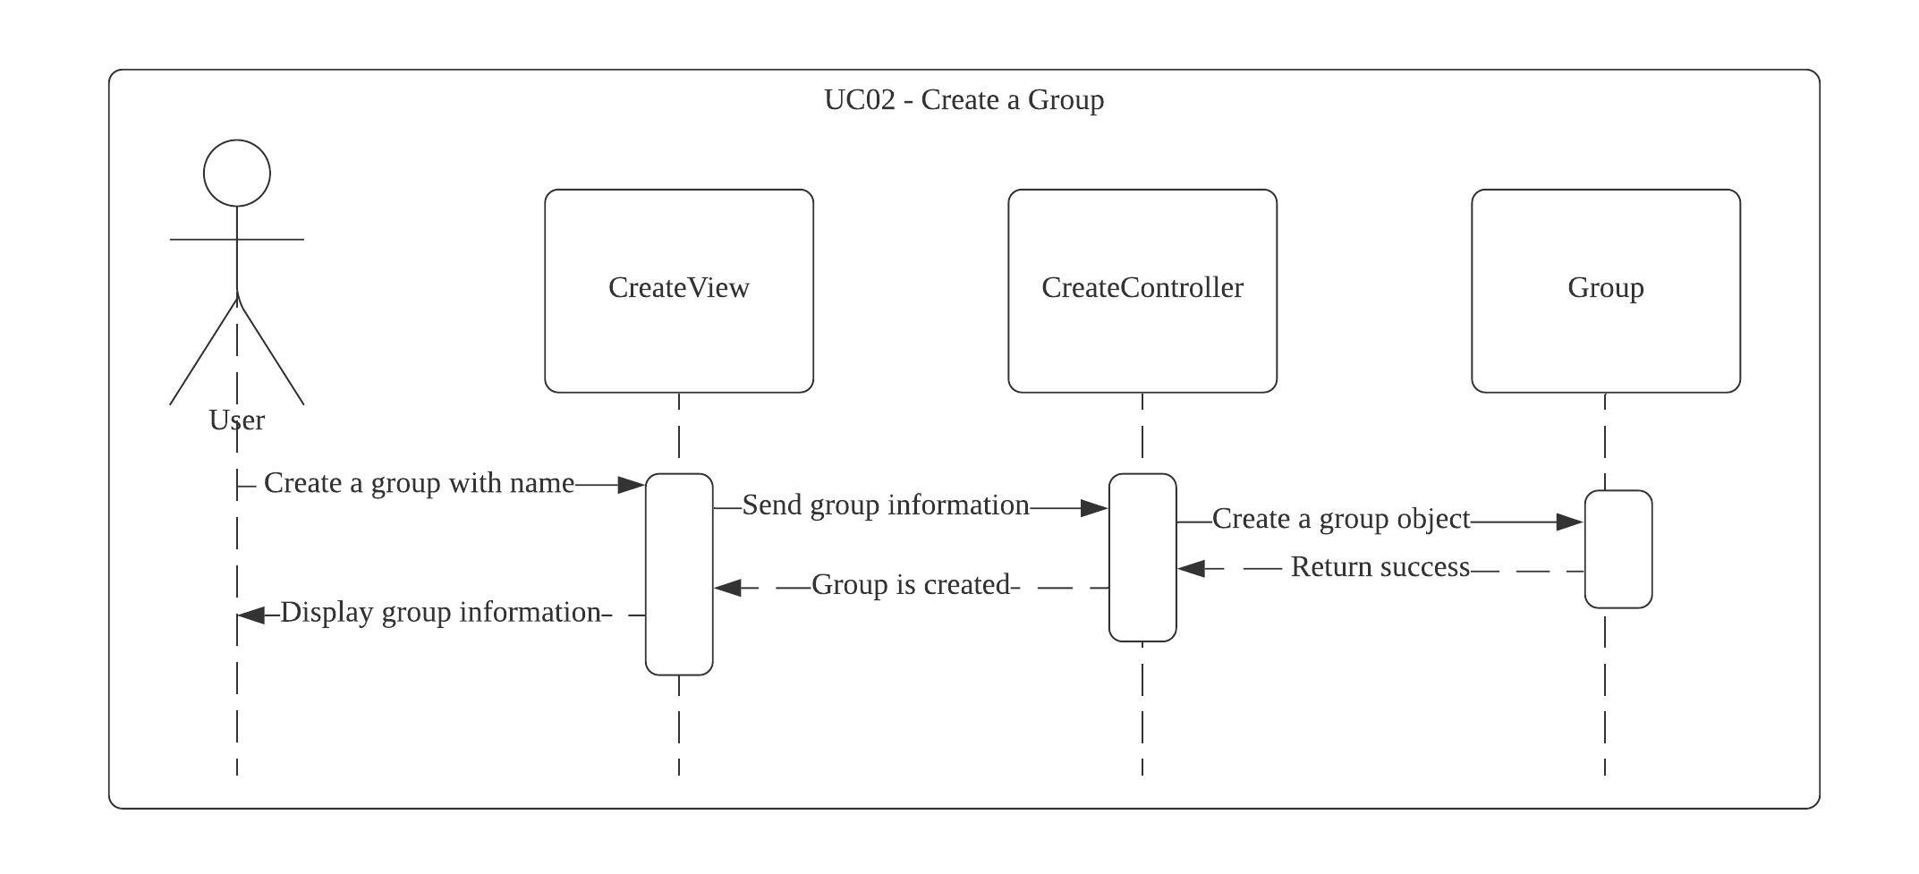
Sequence Diagram: UC02 - Create a Group
Notes:
Group1 : Group
There should be an object notation with the class.

Slide 30
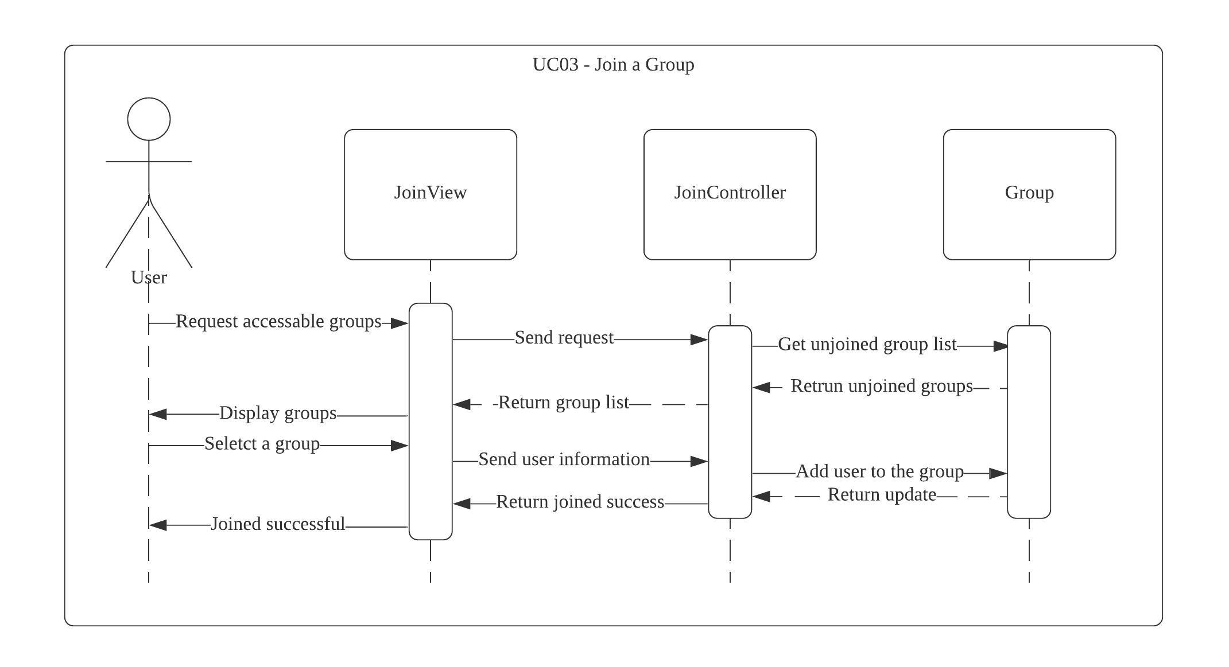
Sequence Diagram: UC03 - Join a Group
Notes:
Request accessible group
Shouldn’t have arrows coming back the user
Sequence diagram notation are not used correctly
Invitation from moderator to join a group not mentioned

Slide 31
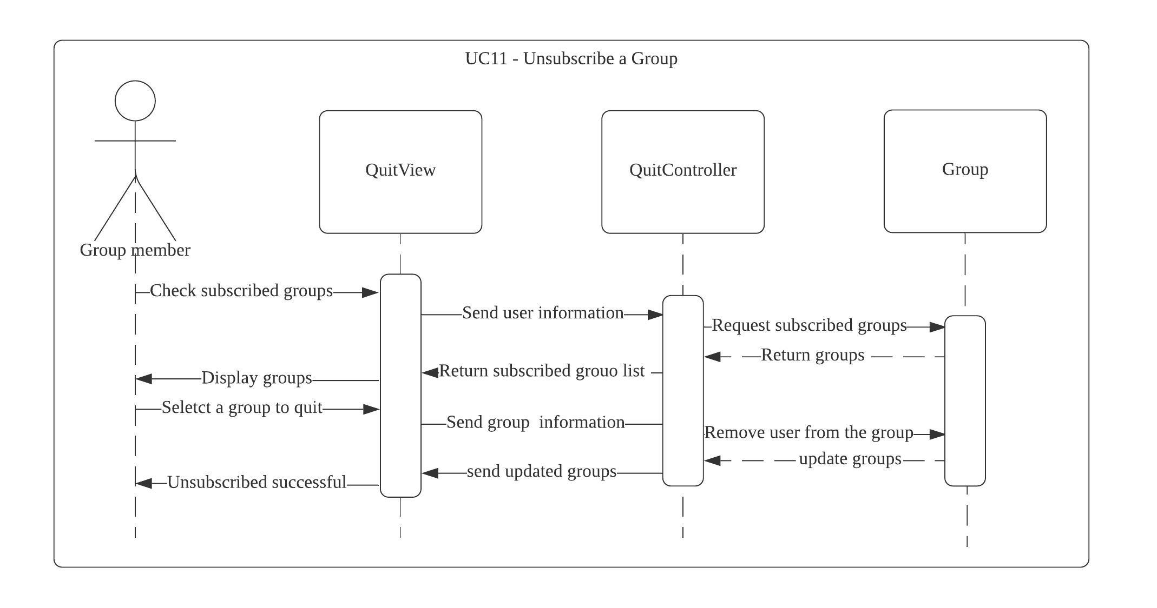
Sequence Diagram: UC11 - Unsubscribe a Group
Notes:
Shouldn’t have arrows coming back the user
Sequence diagram notation are not used correctly
There should be a cross after you quit the group
This sequence diagram should be specific to 1 group
Group1: Group
Everything above select a group to quit shouldn’t be there

Slide 32
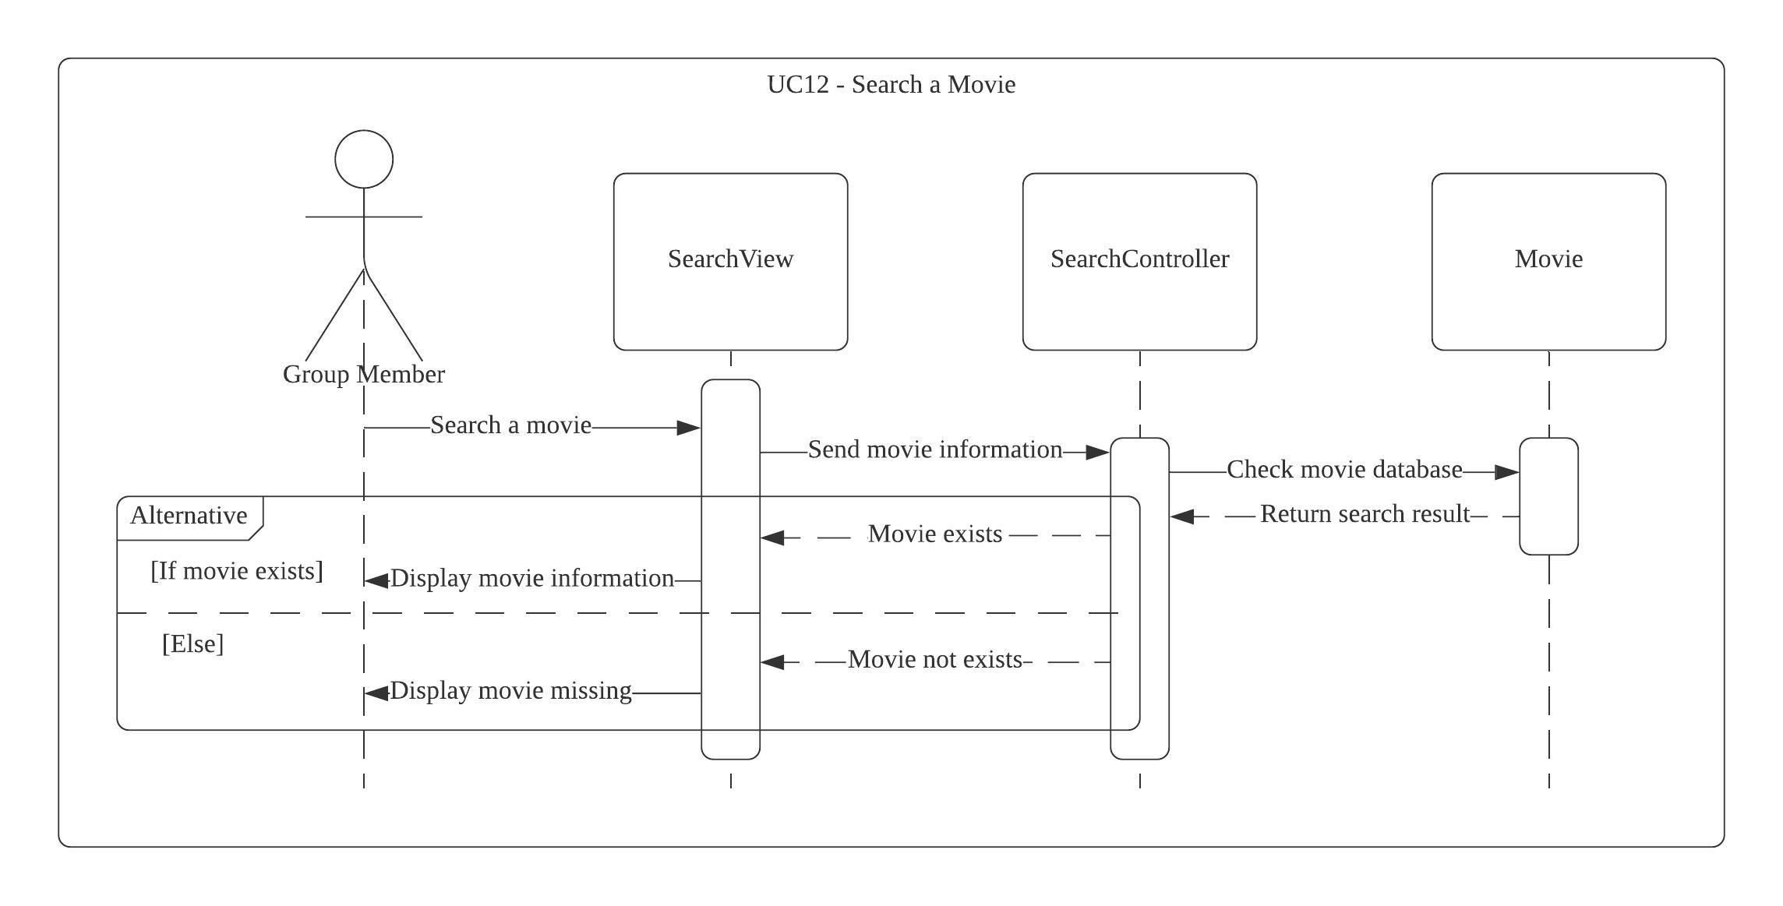
Sequence Diagram: UC12 - Search a Movie

Slide 33
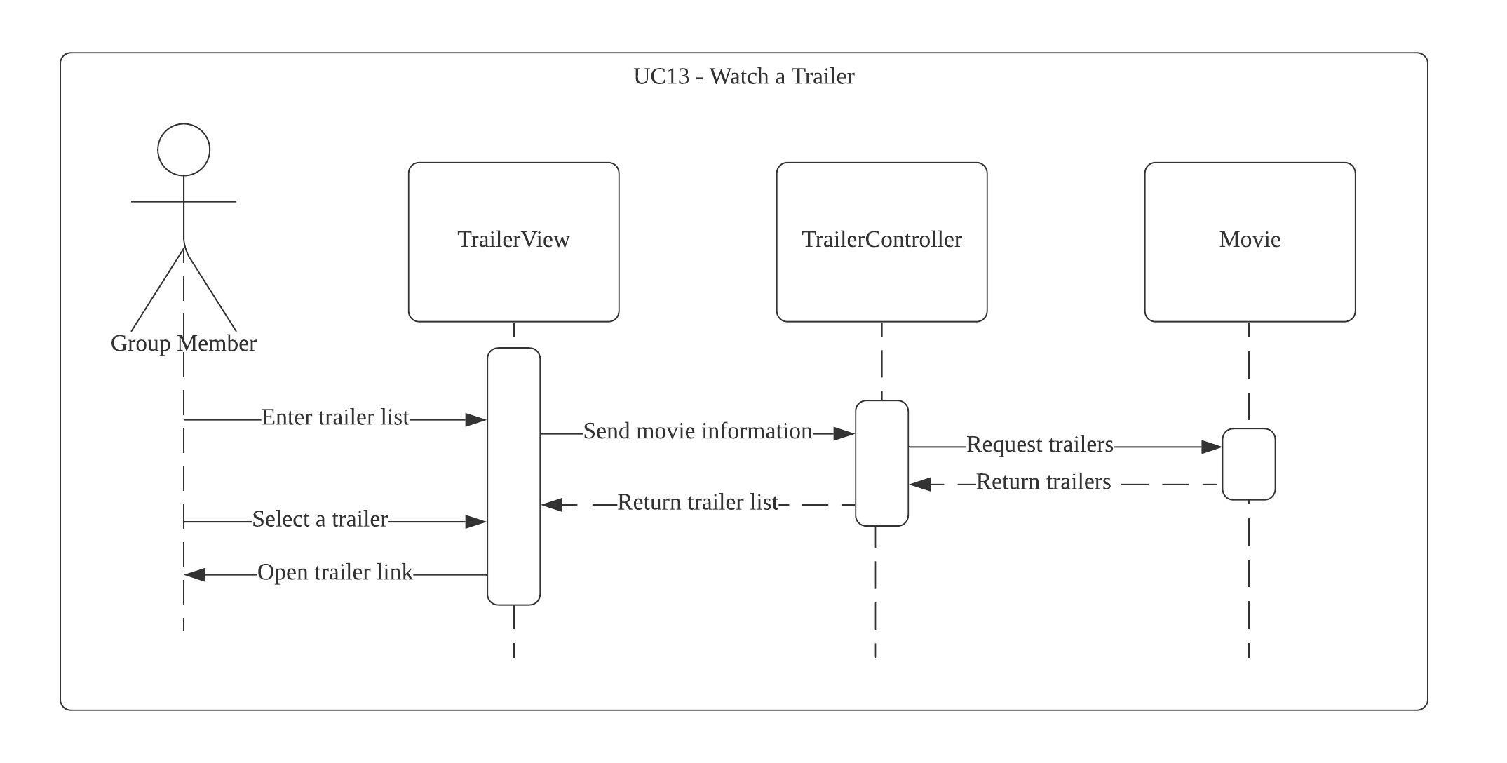
Sequence Diagram: UC13 - Watch a Trailer
Notes:
Enter trailer list shouldn’t be there
Search that leads to Watch a trailer is missing
Open trailer links should not be there since it’s mentioned that trailers are on external site.

Slide 34
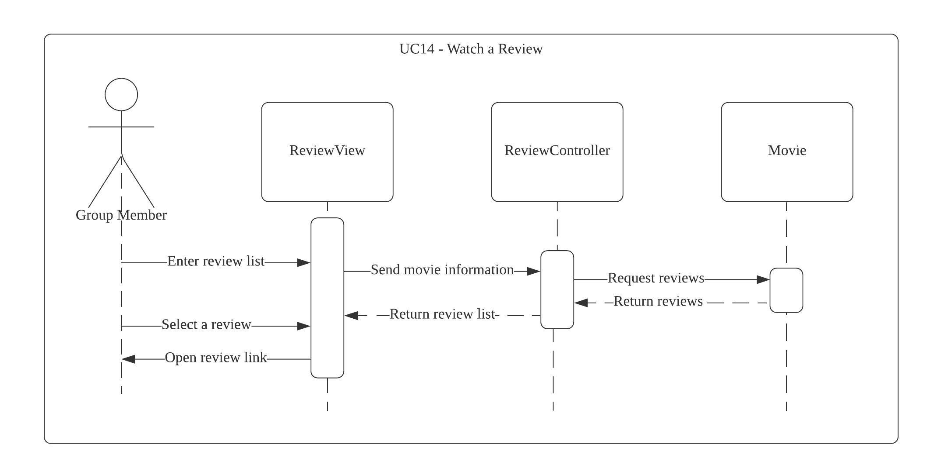
Sequence Diagram: UC14 - Watch a Review
Notes:
Enter reviews list shouldn’t be there
Search that leads to READ a review is missing
Open review links should not be there since it’s mentioned that review are on external site.

Slide 35
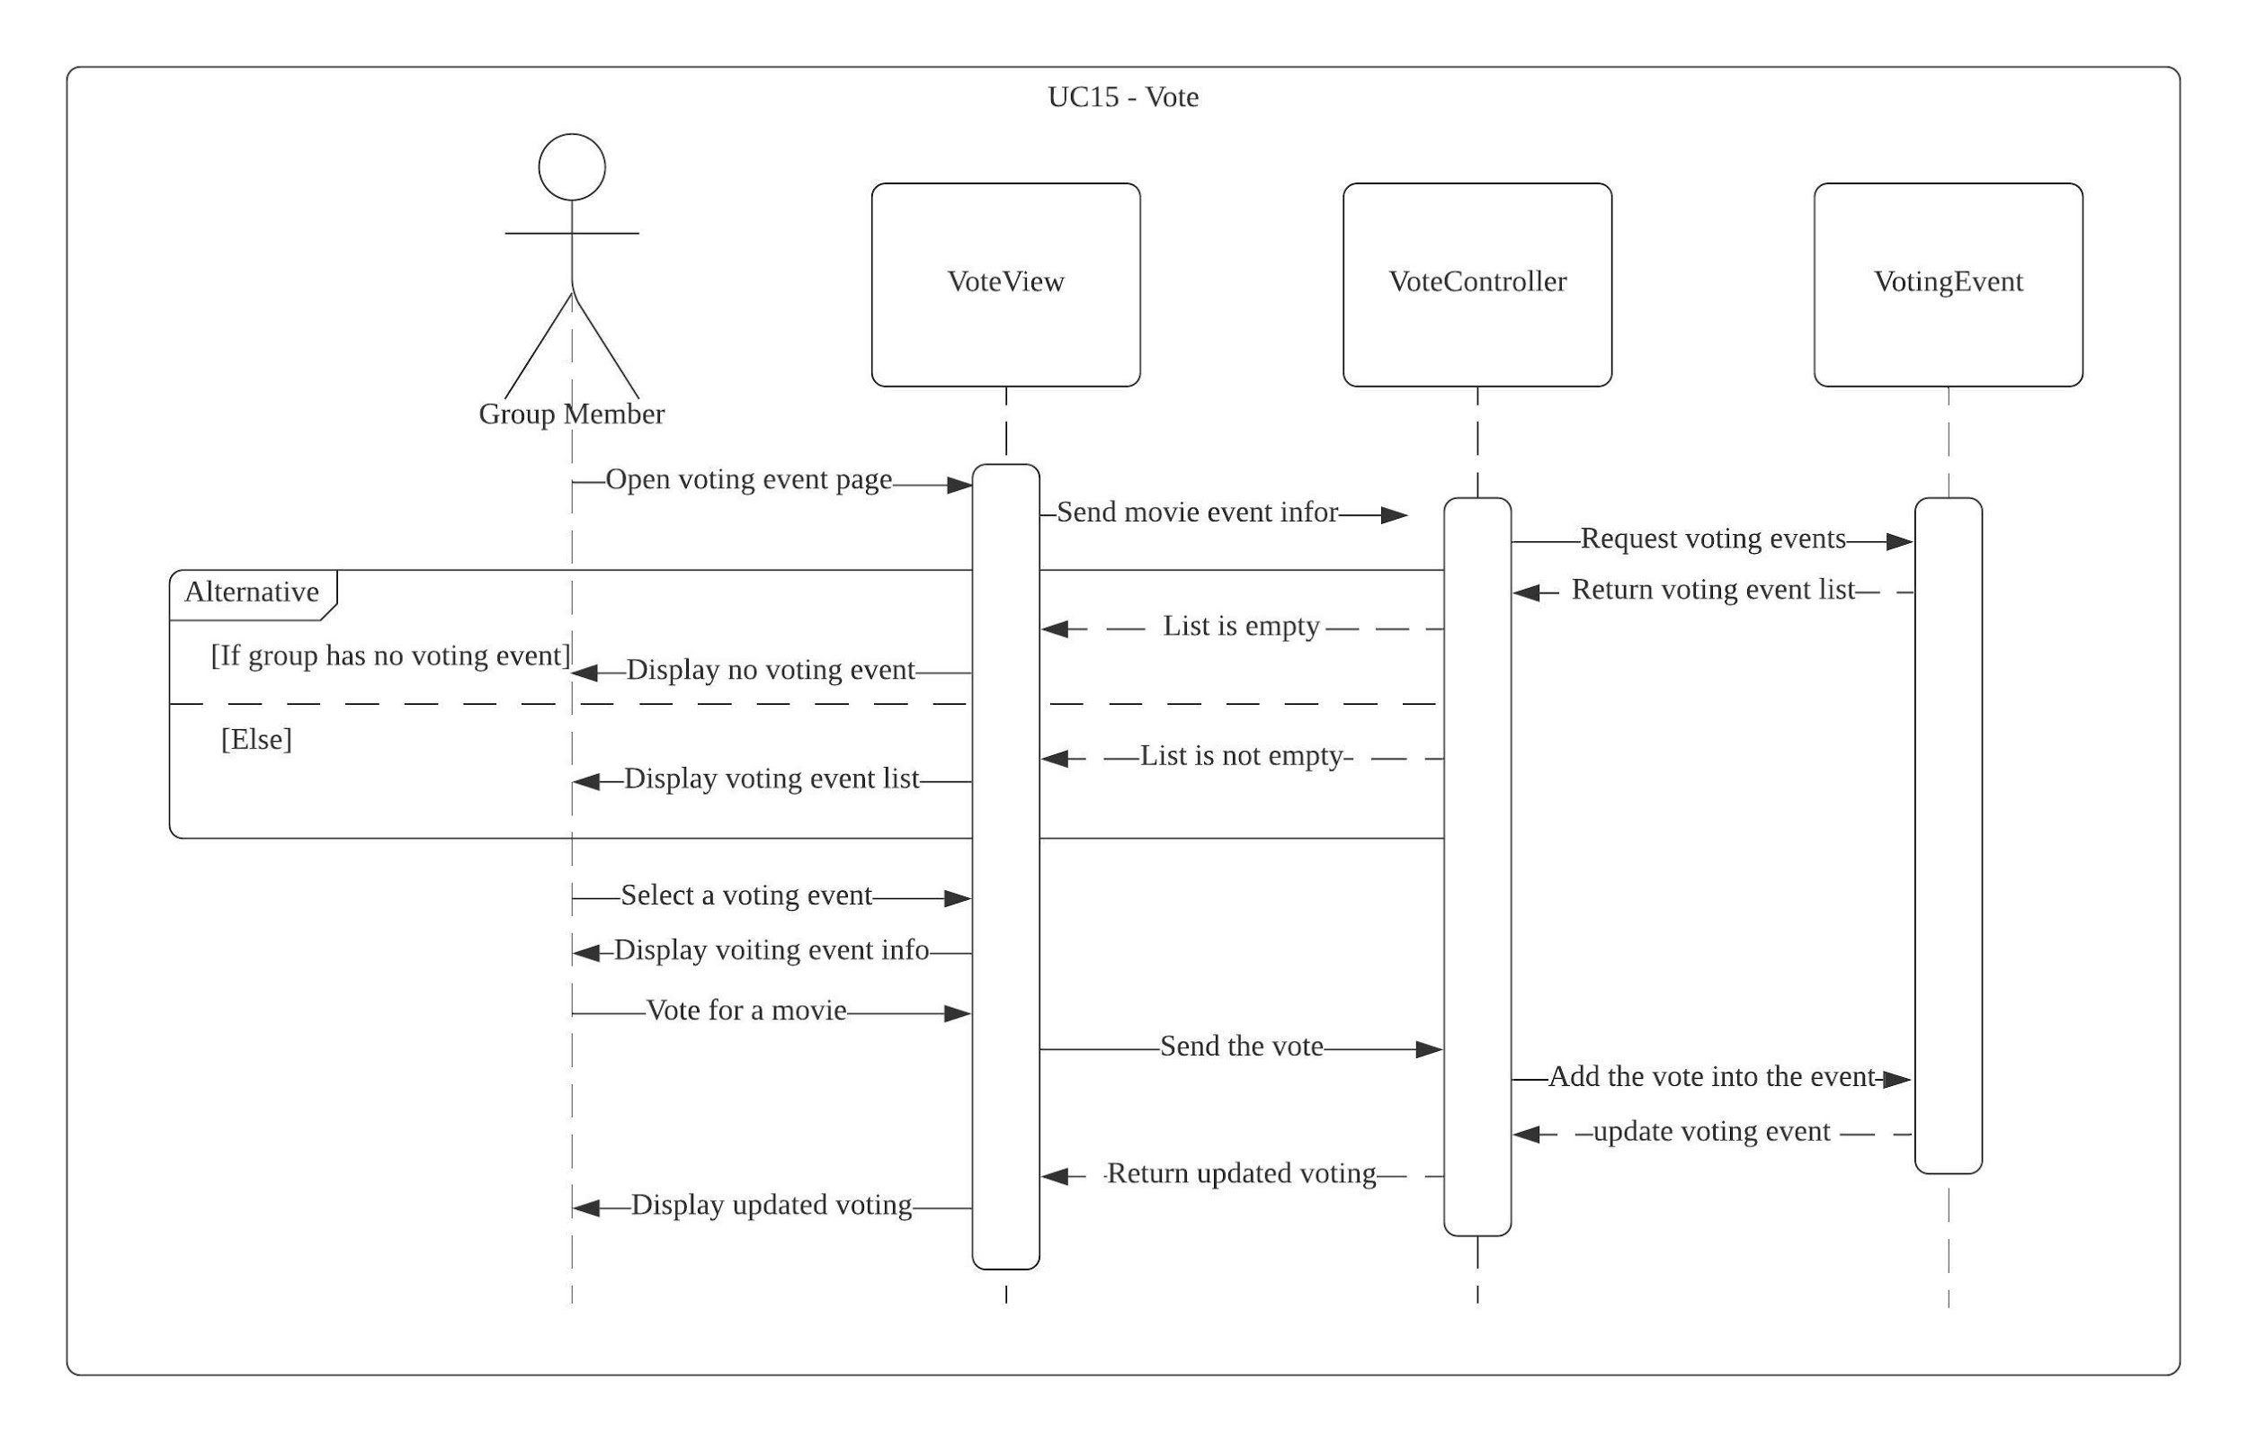
Sequence Diagram: UC15 - Vote

Slide 36
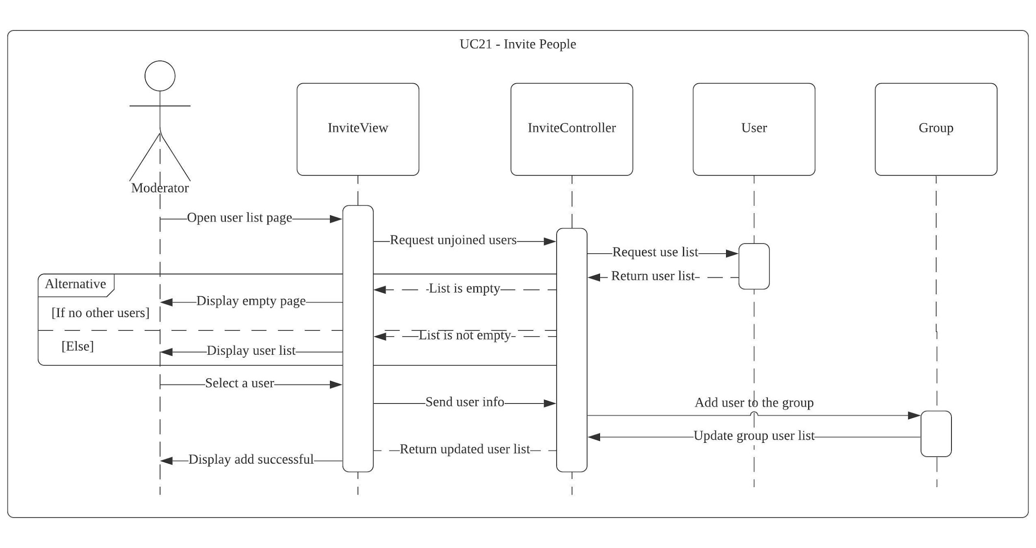
Sequence Diagram: UC21 - Invite People
Notes:
Specific to 1 user 1 group
Not mentioned of User1 : User, Group1: Group

Slide 37
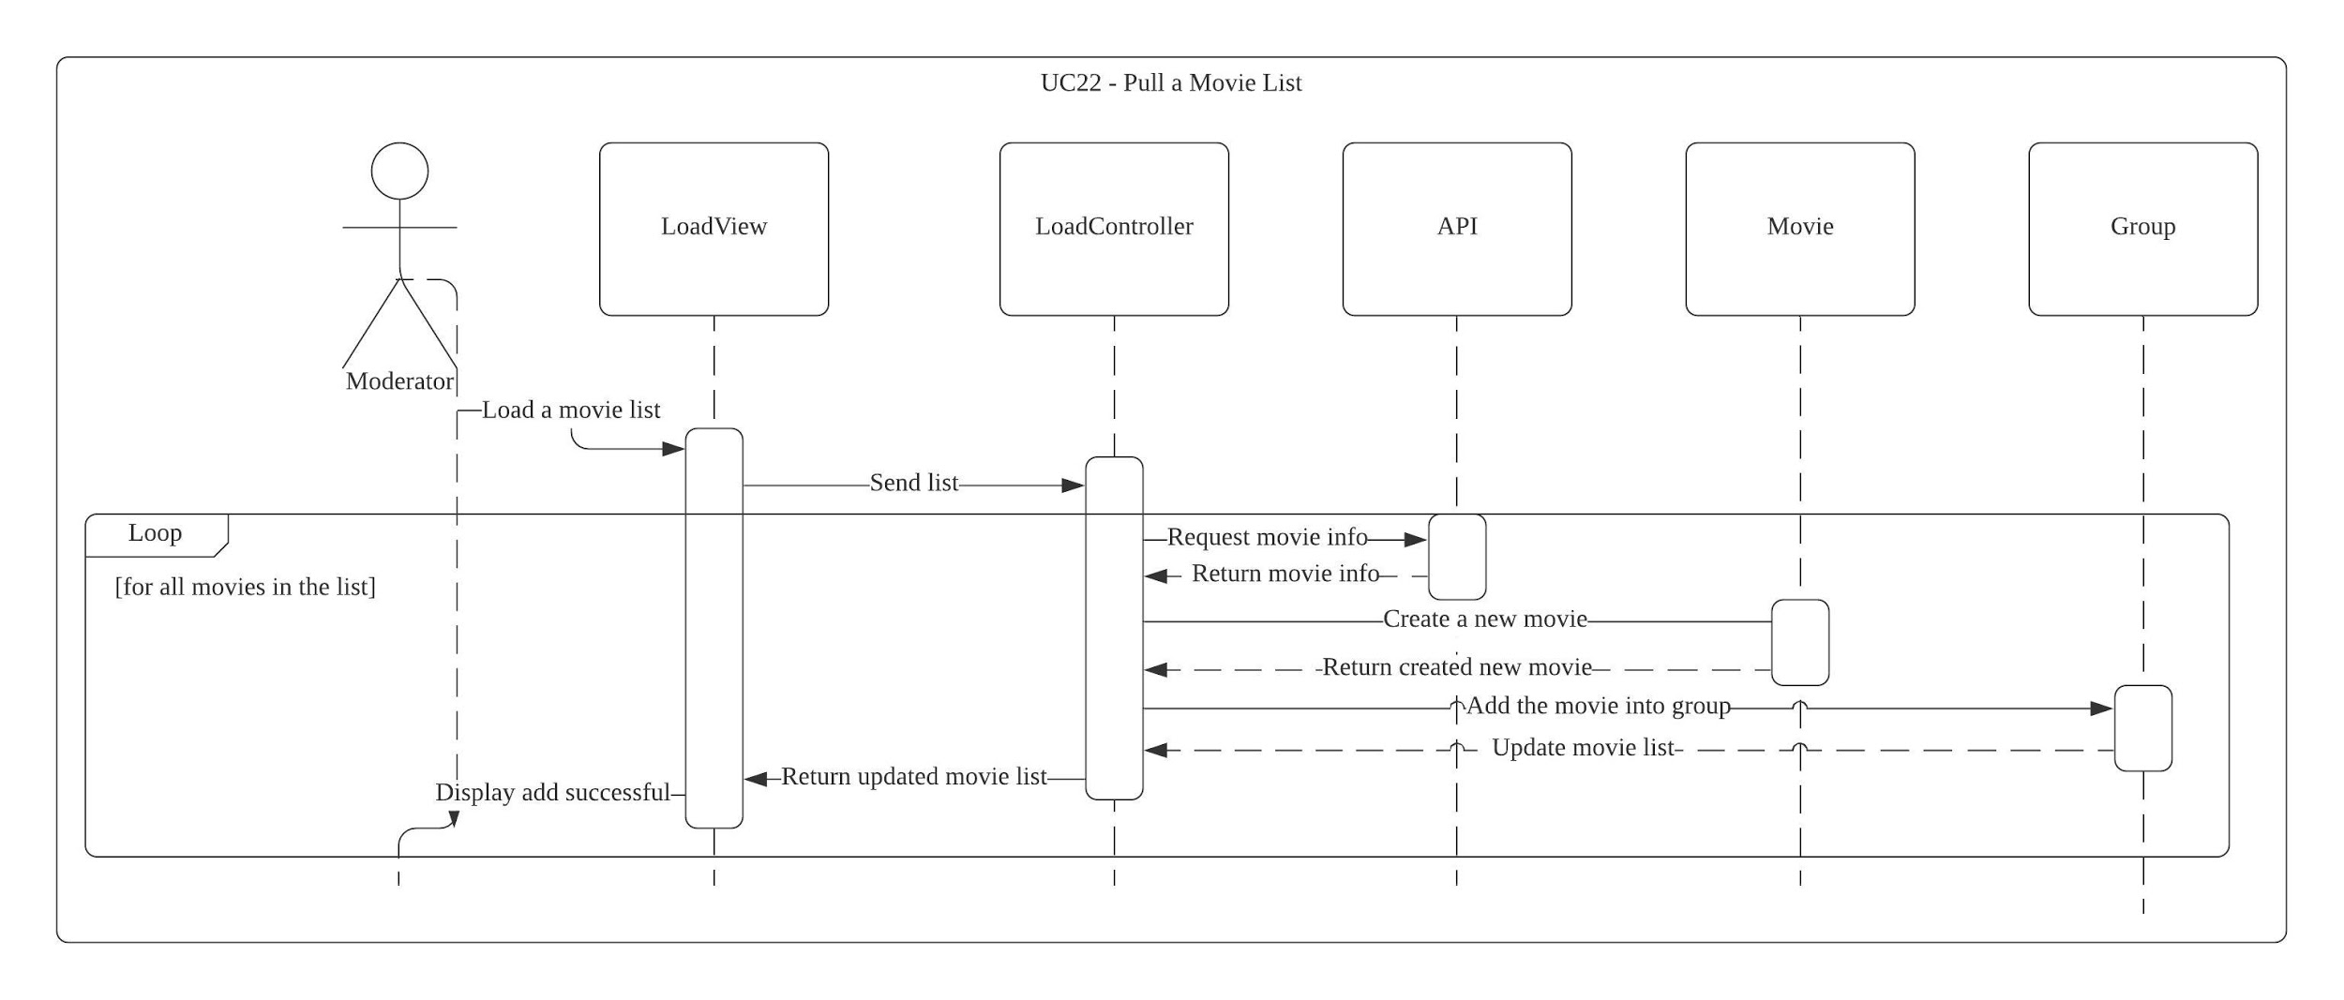
Sequence Diagram: UC 22 - Pull a Movie List
Notes:
Create a new movie ??(List) doesn’t have a directional indication.
Directing movie isn’t part of the use case
Group 1: Group
Load movie list should be from load controller

Slide 38
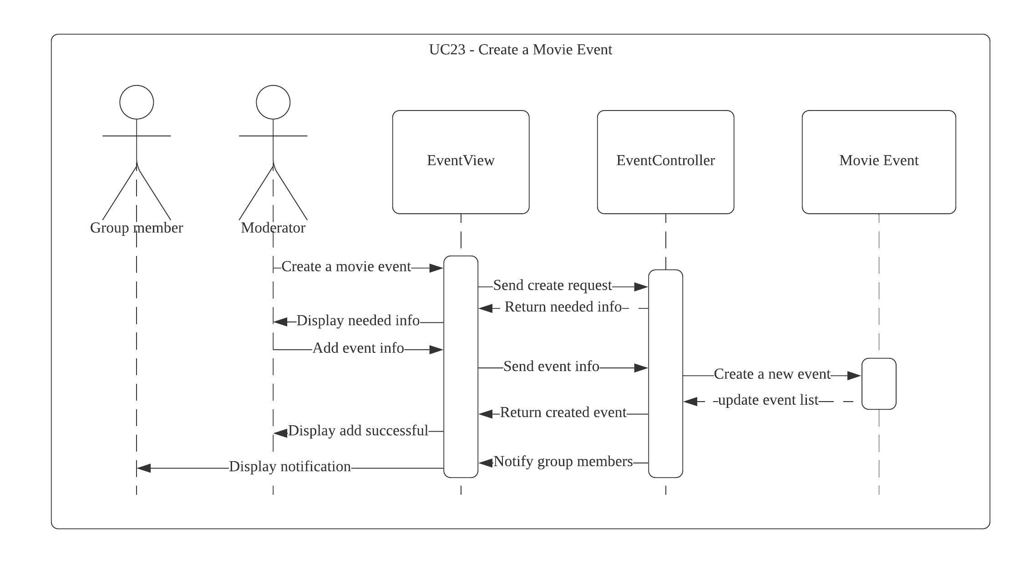
Sequence Diagram: UC23 - Create a Movie Event
Notes:
What does the needed info means? Why needed?

Slide 39
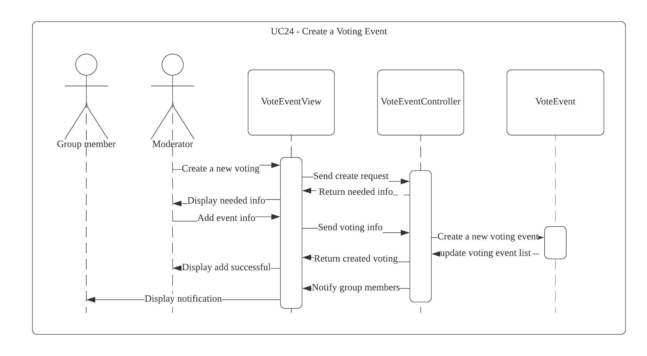
Sequence Diagram: UC24 - Create a Voting Event

Slide 40
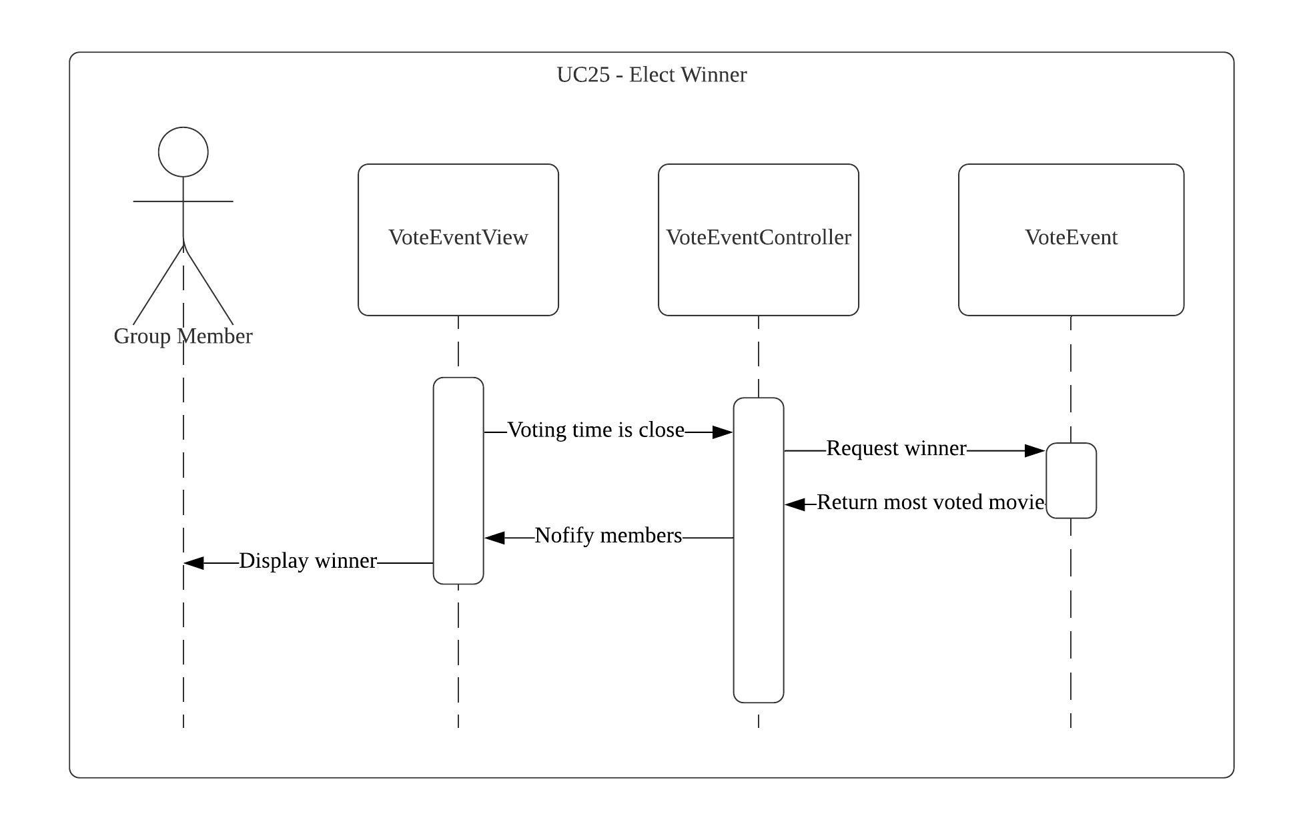
Sequence Diagram: UC25 - Elect Winner
Notes:
NOOOOOOO

Slide 41
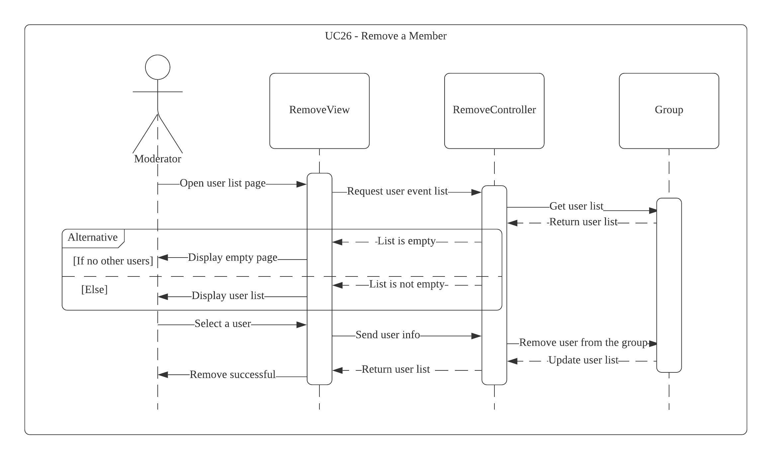
Sequence Diagram: UC26 - Remove a Member
Notes:
Opening and displaying list of users is not specifically for the “Removing a Member”.

Slide 42
Key Issues in Sequence Diagram
UC 02 Create group - Object notation with the class missing
UC 03 Join group - Sequence diagram notation not used correctly .
UC 11 Unsubscribe a group - Sequence diagram notation not used correctly .
UC 13 Watch trailer - Search trailer that leads to watch trailer missing. According the UC diagram(Slide 8) the user must search before watching the trailer .
UC 14 Watch review - Search review missing . According to UC diagram (Slide 8) the user must search before watching the trailer.

Slide 43
Key Issues in Sequence Diagram - 2
7. UC 22 Pull a movie list - Missing arrows and Misdirected functions
8. UC 24 Elect winner - Sequence diagram not required since this function does not interact with the user.
9. UC 26 Remove a member - Opening and displaying list of users not specifically for “Removing a member”

Slide 44
Ways to Resolve Issues in Sequence Diagram
1. UC 02 Create Group - Add object notations to sequence diagrams e.g Group1 : Group
2. UC 03 Join group - Arrows should not be coming back to the user . Mention the invite sent from the moderator in the diagram .
3. UC 11 Unsubscribe group - Fix arrows coming back to the user . Cross after you quit the group . Contents above select a group to quit can be removed
4 . UC 13 Watch Trailer - Enter trailer has to be removed . Fix Search before watching a trailer . Remove open trailer links since trailers are on external website

Slide 45
Ways to Resolve Issues in Sequence Diagram - 2
5. UC 14 Watch Review - Fix search before watching or reading review . Remove open review links since it is on an external website
6. UC 22 Pull a movie list - Add object notations to sequence diagram eg.Group 1 : Group . Load movie list should be from load controller
7. UC 24 Elect winner - Sequence diagram not necessary since it does not interact with the user . Elect winner is an auto-calculate function after voting .
8. UC 26 Remove member - Opening and displaying list of users not specifically for “Removing a member”

Slide 46
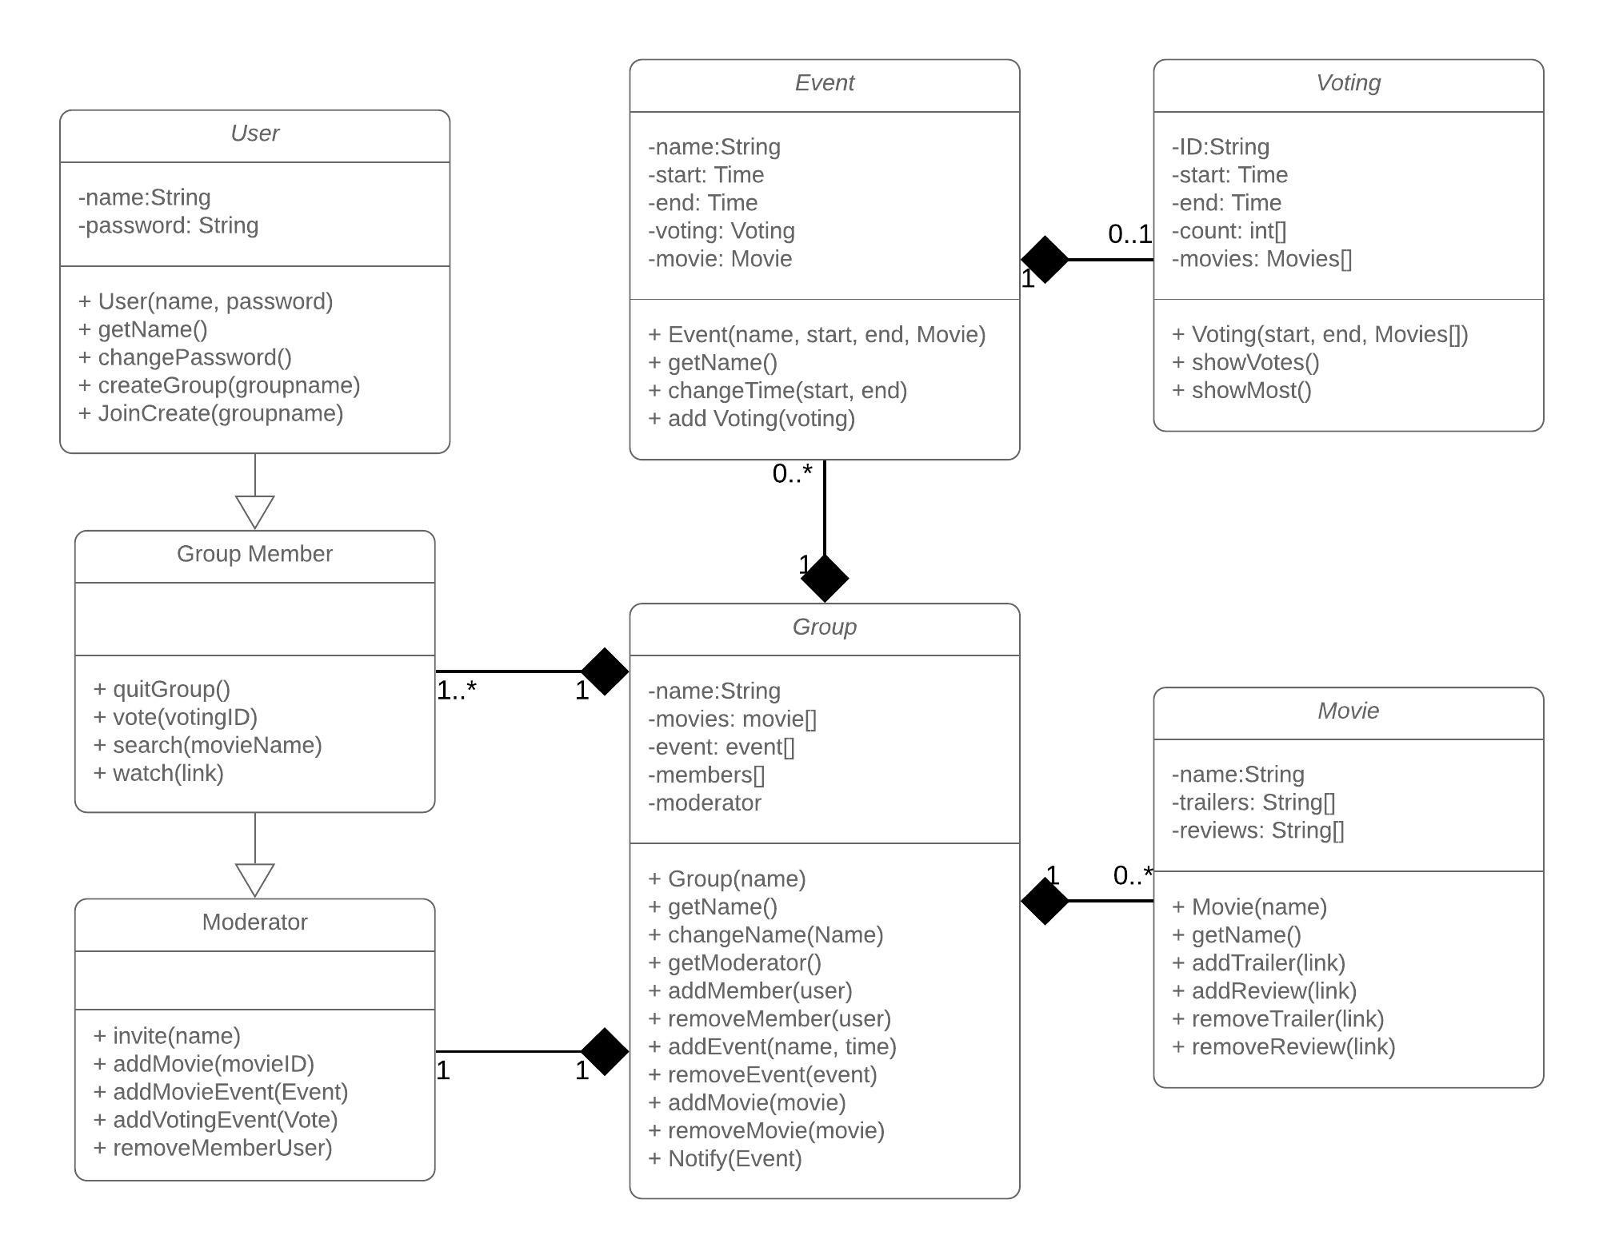
Class Diagram Model
Notes:
Moderator doesn’t inherits from group member
Change Password is use case
What is joincreate
No link between moderator and movie
No link between moderator and event
No link between group member and voting
No link between moderator and event
View history function not present

Slide 47
Key Issues in Class Diagram
Moderator should not inherit from group member
Change Password should not be a function.
“Joincreate” function’s naming convention is wrong as well as the functionality is unclear.
There is no link between moderator and movie.
There is no link between moderator and event.
There is no link between group member and voting.
There is no link between moderator and event.
View History function is missing

Slide 48
Ways to resolve issues in Class Diagram
Moderator should inherit from user and not group member.
Change Password should be added as a use case.
Follow naming convention for “Joincreate” that clearly identifies what it joins and what it creates. Do not merge 2 features in one. Follow ‘Single Responsibility’ principle.
Create a relationship link between moderator and movie.
Create a relationship link between moderator and event.
Create a relationship link between group member and voting.
Create a relationship link between moderator and event.
Create a method to allow the user to ‘View History’.

